Slide 1
Human Safety, Preparedness and Response
Brenda D. Phillips
Panelist
Oklahoma State University
Professor of Fire & Emergency Management

Slide 2
The Base for an Effective Response (in Phillips, Neal, Webb 2011; based on FEMA IS#1;Thomas et al. 2010).
Hazard Identification
Risk Analysis
Develop preparedness campaigns to inform the public of risks and recommend risk reduction strategies. Train people on how to respond to area risks, initiate planning and conduct exercises and drills. Identify mitigation opportunities.
Natural, Technological Terrorist Threats
Past History
New and Emerging Hazards
Location of Utilities, Infrastructure, Health Care facilities and other areas critical to community
People, Concentrated Populations, Vulnerable populations
Areas of weakened structures that increase risk (dams, levees)
Economic analysis and ability to absorb hazard and rebound
Environmental analysis of areas subject to negative impact in the ecosystem

Slide 3
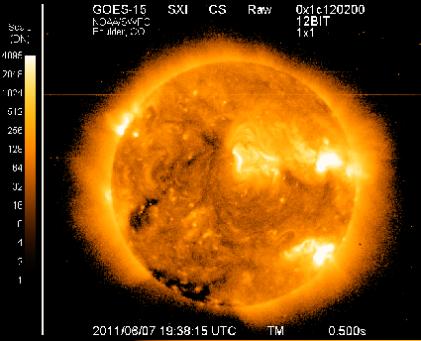
Hazard Identification
Space Weather
Not on the public radar
Not on the EM radar
The learning curve for “new” events
Terrorism (attacks, anthrax, bio-threats)
We just changed the warning system….
Tsunamis

Slide 4
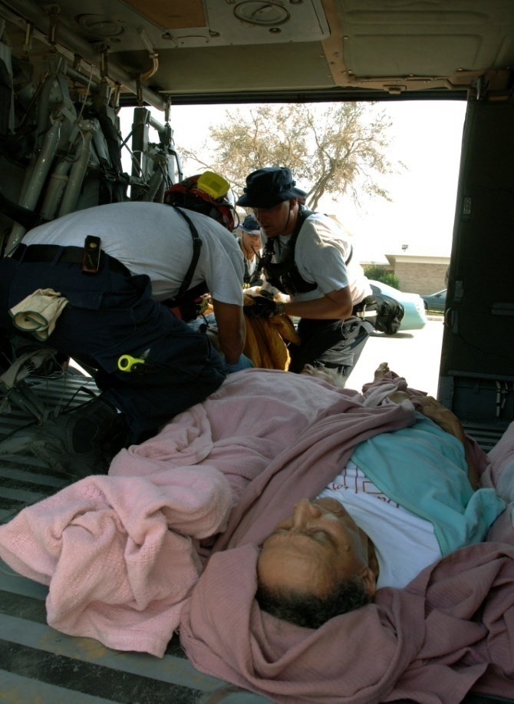
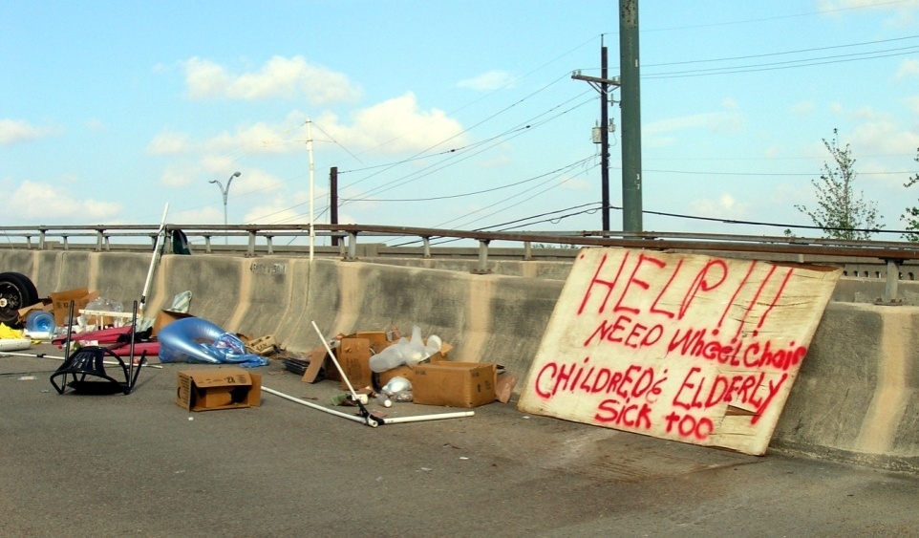
Risk Analysis
Individual, household, family; congregate living centers
Agency, organization
Professional emergency management community
Left, Hurricane Katrina, courtesy of Pam Jenkins and Barbara Davidson; above, FEMA News Photo

Slide 5
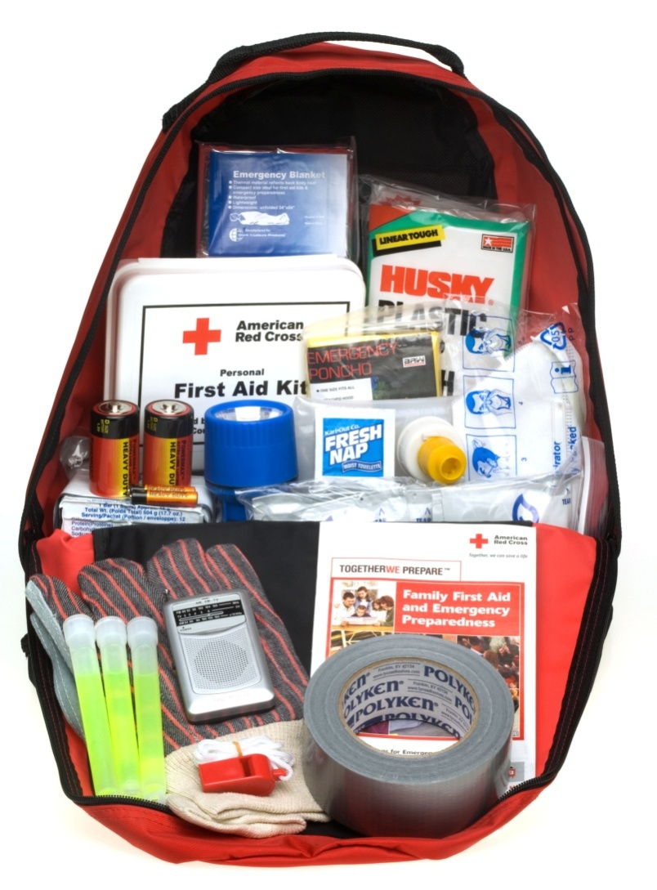
How important is preparedness?
What do I put in my ready kit?
Disasters are a low priority
Household levels
Organizations and agencies
Even emergency managers are learning space weather
Maybe it’s the wrong question
Who can prepare?
What are the barriers?
What can we build on to prepare?
What do we need to do that is “new”?

Slide 6
Factors Affecting Household Preparedness (In Phillips, Neal, Webb 2011; based on Tierney et al.2001)
Household Characteristics
(e.g., presence of children)
Hazard Awareness and Risk Perception
Previous Disaster Experience

Slide 7
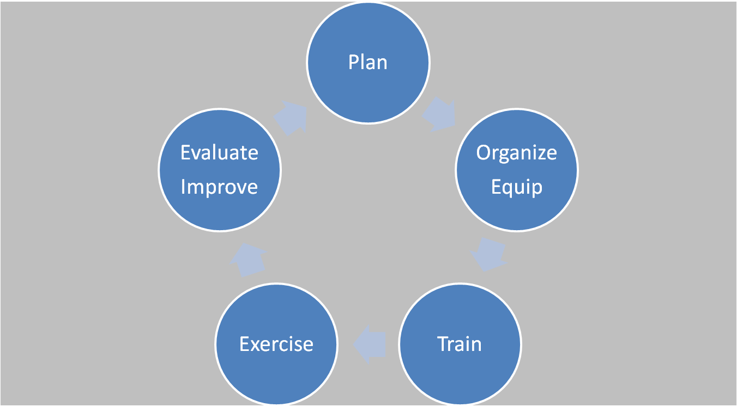
Preparedness Cycle (Sources: Phillips, Neal and Webb, Introduction to Emergency Management ,Oct 2011; adapted from www.fema.gov/prepared)
Who is qualified to evaluate our exercise?
Is an all hazards approach still right?
Preparedness
Cycle
Who should be involved in an exercise?
What do I train for?

Slide 8
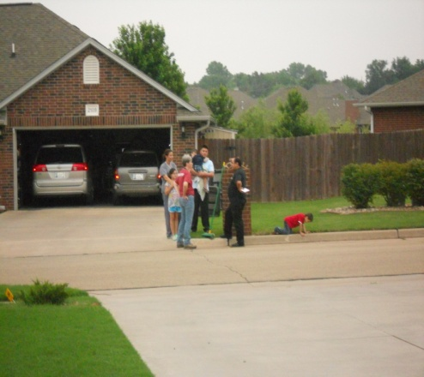
Will they respond? (Mileti 1999; Sorsen and Vogt Sorensen 2006; National Research Council 2010)
Is it the geomagnetic storm I respond to or the blackout?
Socially, geographically isolated; off the grid, congregate care, new mother
Receiving the warning
Understanding it
Personalize it
Action feasible?
Take action
Confirming
Is it credible?
Language (ASL?); cognitive disability; the “science” of it
Cost of short and long term response
Are they talking about me?
Who do I know that understands space weather?

Slide 9
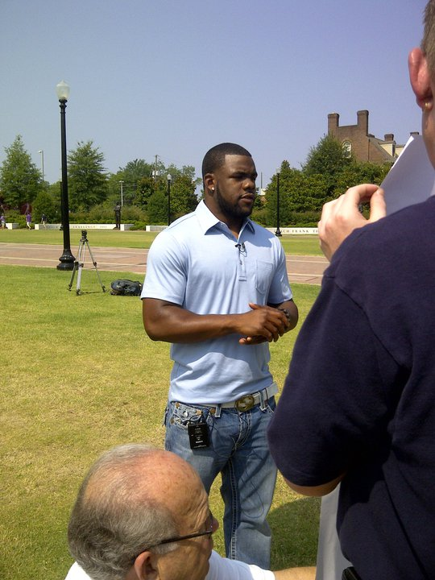
Effective Preparedness Campaigns
Base it on what people know, on previous disasters, like blackouts, power outages
User-friendly materials
How are you going to map that? Projected geomagnetic storm path?
Diversify the materials
No new warning system
Watches, Warnings
Redundancy
Involve people that people relate to: Heisman Award Winner Mark Ingram helps the Alabama EMA.

Slide 10
Space Weather in the context of daily life
It’s not something you see everyday. But, it certainly is cool. According to The Space Weather Prediction Center, a dramatic eruption, known as a Geomagnetic Storm, occurred earlier today on the sun that is expected to impact us earthlings by Wednesday beginning as early as the lunch time hour. The “disturbance” is hauling at a speed of 3.1 million mph…. This means that there is a good chance that we could experience a small disruption in radio and radar as well as in magnetic compasses and the possibility of seeing the “Northern Lights” at much lower latitudes……Either or, grab a blanket..cause this is gonna be cool. (OK, bad joke there).
(KOCO TV, OKC,facebook page linked to weatherblog, June 7, 2011)

Slide 11
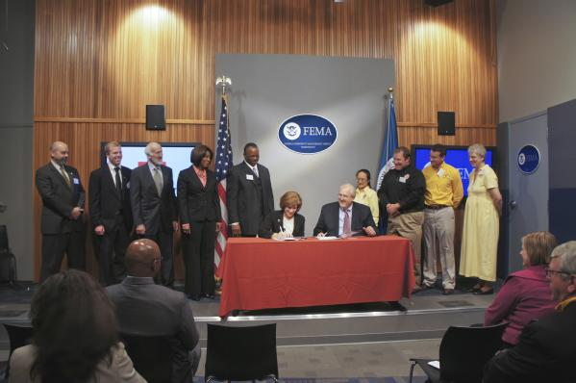
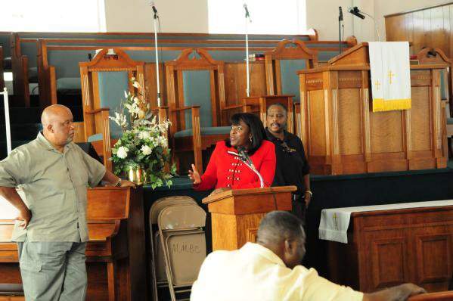
Points of Intervention
Existing initiatives –
www.ready.gov
Key partners
Family, social networks, agencies, VOADs, CERTs
Emergency managers
Weather “family”
People’s daily lives
Social media – where’s the facebook page? Blogs for specific user groups
Events – Grandparents’ day, Cinco de Mayo
Grocery store “recycle” bags
PSA’s – Spanish language stations; Schools
Top, FEMA MOU with NVOADs; Bottom, Alabama post disaster meeting in a local church (FEMA/Tim Burkitt).

